Slide 1
Introduction to
International
Business
Notes:
Chapter 1: Globalization and International Business

Slide 2
LEARNING OUTCOME:
Define globalization and international business and explain how they affect each other
Grasp why companies engage in international business and why its growth has accelerated
Illustrate the different ways a company can accomplish its global objectives
Recognize the need to apply social science disciplines to understand how international and domestic business differ

Slide 3
Introduction
International business:
International business encompasses all commercial activities that take place to promote the transfer of goods, services, resources, people, ideas, and technologies across national boundaries.
International business occurs in many different formats:
The movement of goods from country to another (exporting, importing, trade)
Contractual agreements that allow foreign firms to use products, services, and processes from other nations (licensing, franchising).
The formation and operations of sales, manufacturing, research and development, and distribution facilities in foreign markets
NOTE : increasingly foreign countries are a source of both production and sales for domestic companies
Notes:
What is international business? International business consists of all commercial transactions that take place between two or more countries. International business activities allow us to get more variety, better quality, and/or lower prices.
International business activities may be performed by private companies motivated by profit, or by governments that undertake them either for profit or for political reasons.

Slide 4
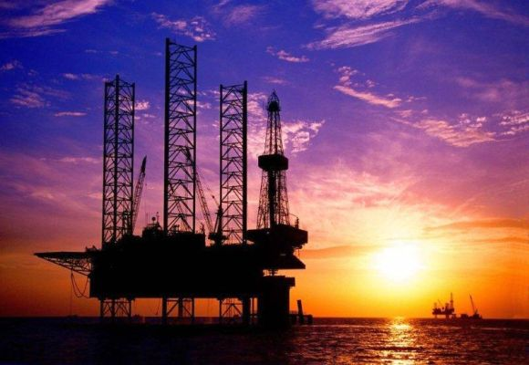
Indian Companies with max revenue from Foreign Countries
ONGC Videsh :
The wholly owned subsidiary of Oil and Natural Gas Corporation, this company was rechristened in 1989 from earstwhile Hydrocarbons India Private Limited.
Over a period of time, ONGC Videsh or OVL has grown to become the second-largest E&P (exploration and production) company in India both in terms of oil production and oil and gas reserve holdings.
The company grew its global footprints with acquisition of oil and gas assets and now has projects in 16 countries.
Rank: 1
Tran nationality Index: 77 per cent
Total revenues: Rs 22,700 crore (Rs 227 billion)
Revenues from foreign operations: Rs 22,100 crore (Rs 221 billion)
Total assets: Rs 25,500 crore (Rs 255 billion)
Assets abroad: Rs 25,200 crore (Rs 252 billion)
Total employees: 246
Employees abroad: 83

Slide 5
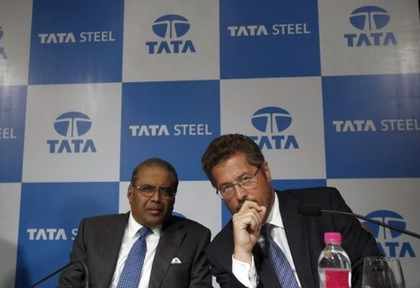
Tata Steel
Established in 1907, it is among the top ten global steel companies in the world with an annual crude steel capacity of 28 million tonnes per annum (mtpa).
The company is now one of the world's most geographically-diversified steel producers, with operations in 26 countries and a commercial presence in over 50 countries.
Its $12.98 billion acquisition of Anglo-Dutch steelmaker Corus in 2006 was one of the biggest acquisitions abroad by an Indian company.
Rank: 2
Transnationality Index: 63 per cent
Total revenues: Rs 132,900 crore (Rs 1,329 billion)
Revenues from foreign operations: Rs 97,700 crore (Rs 977 billion)
Total assets: Rs 125,800 crore (Rs 1,258 billion)
Assets abroad: Rs 75,700 crore (Rs 757 billion)
Total employees: 81,622
Employees abroad: 45,829
Image: Tata Steel's Managing Director Hemant Nerurkar (L) and Tata Steel Europe's Managing Director Karl-Ulrich Koehler.

Slide 6
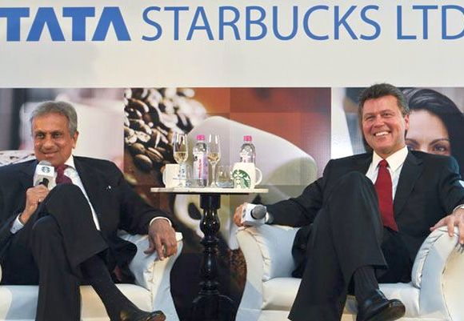
Tata
Global Beverages
It started out as an international company in 1962 with a joint venture between Tata Sons and James Finlay and Company, a UK-based Tea plantation. It was called Tata Finlay.
After the partner opted out in 1983, the company was rebranded as Tata Tea. The company set out on a path with global ambitions starting with the acquisition of Tetley in 2000. Since then, it has acquired Good Earth, Jemca, Vitax, Eight O’ Clock Coffee and Himalayan.
When Starbucks was looking for a partner in India, Tata Global Beverages was the obvious choice. Both the company has a 50:50 joint venture called Tata Starbucks.
Rank: 3
Transnationality Index: 60 per cent
Total revenues: Rs 6,600 crore (Rs 66 billion)
Revenues from foreign operations: Rs 4,600 crore (Rs 46 billion)
Total assets: Rs 6,400 crore (Rs 64 billion)
Assets abroad: Rs 5,000 crore (Rs 50 billion)
Total employees: 2,218
Employees abroad: 732
Click NEXT to read more…
Image: Vice Chairman of Tata Global Beverages R.K. Krishna Kumar and President of Starbucks China and Asia Pacific John Culver (R).
Photographs: Danish Siddiqui/Reuters

Slide 7
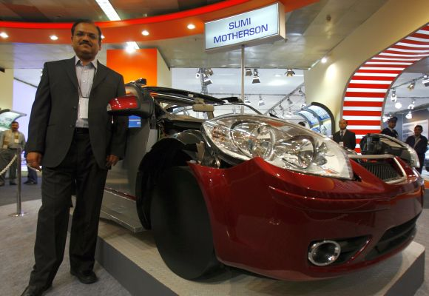
Motherson Sumi Systems :
The company came into existence as a joint venture between India’s Samvardhana Motherson Group and Japan's Sumitomo Wiring Systems.
The company is a leading automotive mirror and wiring harness manufacturer for passenger cars.
After growing organically for many years and having presence in all important markets, the company acquired Visiocorp and Peguform to further expand its presence. It now has offices and manufacturing units in 24 international and 11 Indian locations.
Rank: 4
Transnationality Index: 60 per cent
Total revenues: Rs 14,900 crore (Rs 149 billion)
Revenues from foreign operations: Rs 10,500 crore (Rs 105 billion)
Total assets: Rs 12,000 crore (Rs 120 billion)
Assets abroad: Rs 8,900 crore (Rs 89 billion)
Total employees: 44,208
Employees abroad: 15,359
Click NEXT to read more…
Image: Chief Operating Officer Pankaj K. Mital of the Wiring Harness Division of Motherson Sumi Systems at Auto Expo in New Delhi.

Slide 8
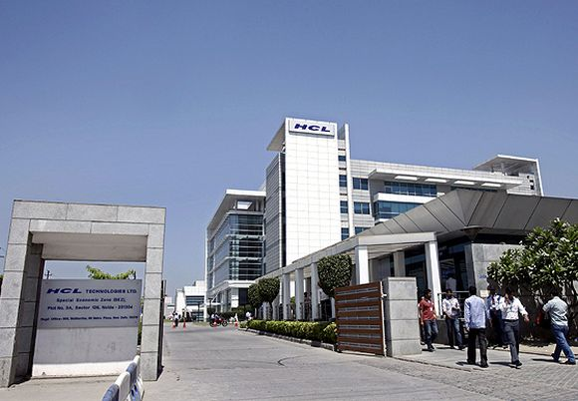
HCL Technologies
A $4.5 billion global technology company, HCL Technologies has offices in 31 countries. It is also the fifth largest IT company in India.
HCL technologies came into existence in 1991 when the parent company – HCL Enterprise – spun off its R&D division to focus on the growing IT services industry.
Rank: 5
Transnationality Index: 57 per cent
Total revenues: Rs 20,800 crore (Rs 208 billion)
Revenues from foreign operations: Rs 19,900 crore (Rs 199 billion)
Total assets: Rs 18,300 crore (Rs 183 billion)
Assets abroad: Rs 10,800 crore (Rs 108 billion)
Total employees: 84,319
Employees abroad: 15,201

Slide 9
Introduction
It is important to study international business because :
  Most companies are either international or compete with international companies.
  Global events and competition affect almost all companies, regardless of industry.
  International companies have more complex environments than domestic firms.
Notes:
Why should you study international business? There are many reasons. One of the most important is because global events affect companies of all sizes and in all industries. In fact, managers today need to consider where in the world to obtain the inputs they need of the required quality and at the best possible price and also where they can best sell the product or service that they’ve put together from those inputs. In many cases, managers may find that they can be more competitive by engaging in global business transactions.
It’s also important to recognize that the best way of doing business abroad may not be the same as the best way at home. When a company operates internationally, it engage in modes of business such as exporting and importing that differ from those in which it engages domestically. In addition, physical, social, and competitive conditions differ among countries and affect the optimum ways to conduct business. So we often find that companies operating internationally have more diverse and complex operating environments than those that conduct business only at home.
Even if you aren’t working at an international company it’s important to understand international business complexities because overall national conditions— things like profits, employment security and wages, consumer prices, and national security are all affected by the international operations of companies and by government regulations of those operations.

Slide 10
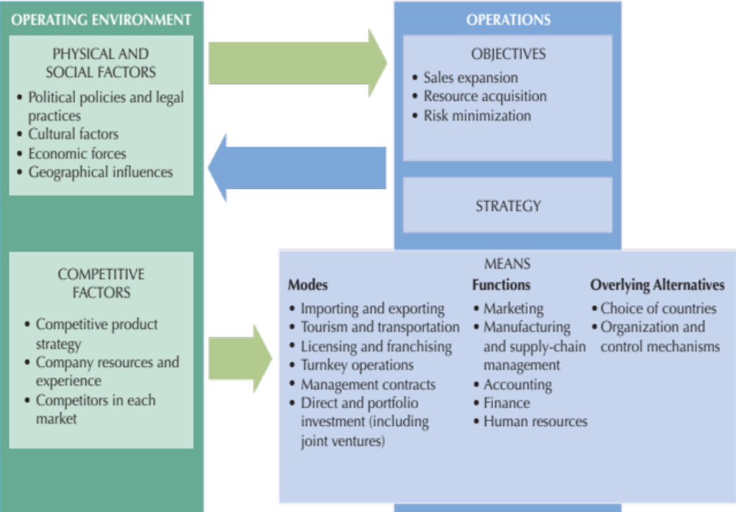
Factors in International Business Operations
Notes:
This Figure shows the complex relationships among conditions and operations that a firm may face when its conducts some of its business internationally. We’ll be referring back to this Figure throughout the chapter.

Slide 11
Introduction
Globalization Globalization is the word used to describe the growing interdependence of the world's economies, cultures, and populations, brought about by cross-border trade in goods and services, technology, and flows of investment, people, and information..
Notes:
What is globalization? Globalization refers to the widening set of interdependent relationships among people from different parts of a world that is divided into nations.
The term also refers to the integration of world economies through the reduction of barriers to the movement of trade, capital, technology, and people. Throughout history, human contacts over ever-wider geographic areas have expanded the variety of available resources, products, services, and markets.
Today, so many different components, ingredients, and specialized business activities go into products that we’re often challenged to say exactly where they were made. For example Apple’s iPhones are shipped from China and seem to be Chinese, yet less than four percent of their value is actually performed in China!

Slide 12
The term sometimes refers to the elimination of barriers to international movement of goods, services, capital, technology, and people that influence the integration of world economies :
  Example: Boeing 777, a commercial jet airliner have Eight Japanese suppliers, one supplier in Singapore & three suppliers in Italy.

Slide 13
The State of Globalization in 2022 by Steven A. Altman and Caroline R. Bastian
From Harvard Business Review
https://hbr.org/2022/04/the-state-of-globalization-in-2022

Slide 14
Anti-globalisation to green energy: 5 shifts that will shape world economy
Business Standard,June 2022
https://www.business-standard.com/article/specials/anti-globalisation-to-green-energy-5-shifts-that-will-shape-world-economy-122061600878_1.html

Slide 15
Forces Driving Globalization
Increase in and application of technology
Liberalization of cross-border trade and resource movements
Development of services that support international business
Growth of consumer pressures
Increased global competition
Changing political situations and government policies
Expanded cross-national cooperation
Notes:
You may wonder what has been driving globalization. The answer is many different factors. One factor is technology. In recent years, we’ve seen tremendous advances in technology. The pace of new product development is faster than ever, and many companies are finding that in order to keep up, they need to team up with companies in other countries to gain financial resources or specialized capabilities. Firms are also finding that to justify their investments in new product development, they need to expand their sales to other markets.
Another factor driving globalization is the liberalization of cross-border trade. Today, most governments have reduced restrictions on cross-border trade giving their citizens access to a greater variety of goods and services at lower prices. Increased competition from foreign companies also encourages domestic producers to become more efficient. Governments hope that by opening their countries to trade, other countries will also lower trade barriers.
The development of new services that facilitate international business transactions have also increased further driving globalization. In addition, today’s consumers are more informed about foreign products and services and are better able to afford more luxury items. Moreover, more consumers are able to comparison shop to find better deals worldwide. Companies look for growing markets where consumer pressures are highest such as China.
Intense global competition is also driving globalization. Today, companies continually look abroad to increase market share and reduce costs in order to better compete with other firms. Expansion abroad can take many forms: so-called born-global companies start out with a global focus because of their founders’ international experience and because advances in communications give them a good idea of where global markets and suppliers are. Related to this, many new companies locate in areas where there are many competitors and suppliers—a situation known as clustering—which helps them to become quickly aware of foreign opportunities.
Finally, changing political situations and increased cross-national cooperation have allowed international business to flourish. Countries of different political systems are more open than before to conducting international trade with each other. Governments are spending more resources on the improvement of infrastructure facilitating the transport of goods and resources. Furthermore, governments have realized the benefits of international cooperation. In particular, governments engage in international cooperation in order to gain reciprocal advantages, to attack problems jointly that one country acting alone cannot solve, and to deal with areas of concern that lie outside the territory of any nation.

Slide 16
Costs of Globalization
Threats to national sovereignty
  lose freedom to “act locally”
Economic growth and environmental stress
  growth consumes nonrenewable natural resources and increases environmental damage
Growing income inequality and personal stress
  promotes global superstars at the expense of others
Notes:
While there are many benefits to globalization, it remains controversial. Antiglobalization protests have become common at international conferences, and the reaction to government policies is sometimes violent.
Three issues are of particular concern. First, the threat the globalization poses to national sovereignty. According to critics, globalization undermines the ability of a country to act in its own best interests and can make smaller economies overly dependent on larger ones. Moreover, critics contend that even a country’s cultural sovereignty is threatened as products, companies, work methods, social structures and language are homogenized as a result of globalization.
A second concern is the effect of globalization on economic growth and the environment. Because globalization brings growth, more nonrenewable natural resources are consumed and damage to the environment increases. You might think of despoliation through toxic and pesticide runoffs into rivers and oceans, air pollution from factory and vehicle emissions, and deforestation that can affect weather and climate for example. However, others argue that global cooperation actually fosters superior and uniform standards for combating environmental problems, and that companies are encouraged to seek resource-saving and environmentally friendly technologies.
Finally, critics are concerned about the effect of globalization on income equality and personal stress. According to critics the income inequality that is present in many countries today is a result of the global superstar system that has emerged as a consequence of globalization. Critics contend that globalization has facilitated access to a greater supply of low-skilled and low-cost labor and encouraged competition that leads to winners and losers. There is also some evidence that the growth in globalization goes hand in hand not only with increased insecurity about job and social status, but also with costly social unrest.

Slide 17
Costs of Globalization
Offshoring, a type of outsourcing, involves the transferring of production abroad
  it can be beneficial because it reduces costs
  but, it also means that jobs move abroad
Yet, offshoring may also create new, better jobs at home
  Call centers and Back office operation jobs are being outsourced to developing countries.
Notes:
Critics of globalization also worry that the practice of offshoring is shifting too many jobs abroad. But keep in mind, that the practice allows companies to keep costs down, and can actually help create high value jobs at home. IBM’s offshoring strategy for example, allows the company to not only save money and boost sales, but also to create new jobs.

Slide 18
Why Companies Engage in IB
To expand sales
  pursuing international sales increases the potential market and potential profits
To acquire resources
  may give companies lower costs, new and better products, and additional operating knowledge
To diversify or reduce risks
  international operations may reduce operating risk by smoothing sales and profits, preventing competitors from gaining advantage
Notes:
Why should companies engage in international business? A general answer is that going in international can help firms create value. More specifically, going global can help firms expand sales, acquire resources, and diversify or even reduce risks.

Slide 19
Modes of (Economic ) Operations in IB
Merchandise exports
  goods that are sent out of a country.
Merchandise imports
  goods that are brought into a country
Sometimes referred to as visible exports and imports
Notes:
The most popular modes of international business are merchandise exports and merchandise imports. They represent major sources of international revenues and expenditures for countries.

Slide 20
Modes of Operations in IB
Service exports
  provider and receiver of payment .
Service imports
  recipient and payer of payment.
Examples
  Tourism and transportation : William Sisters (Venus and Serena) and other USA Fans take AIR FRANCE from USA to France for French Open tournament. Their Ticket on AIR FRANCE and TRAVEL EXP. In FRANCE are service exports for FRANCE and service imports for USA.
  Service performance.
    turnkey operations :
    ( construction projects performed under contract and transferred to owner when they’re operational.
    management contracts : company provides personnel to perform general or specific functions for another company like Disney’s Management of Theme parks in France and Japan.
  Asset use :
    licensing : (When One Co, allows another Co to use its assets such as trademarks, patents, copyrights or expertise , they received earnings called royalties. Adidas pays for use of Real Madrid’s Team logo on its Jackets.
    Franchising : When one Co. allows another to use a trademark and also assist continuously in its operations eg by providing supplies, management service, or technology . Mc Donald.
Notes:
Services exports and imports are the fastest growing sector in international trade. The most important are tourism and transportation, service performance, and asset use.
Many countries depend on tourism and transportation for both foreign exchange earnings and employment.
Companies pay fees for services rendered in turnkey operations and management contracts. Turnkey operations are construction projects performed under contract and transferred to owners when they’re operational. Management contracts are arrangements in which one company provides personnel to perform general or specialized management functions for another.
Asset use involves allowing another company to use your trademarks, patents, copyrights, or expertise in exchange for royalties. This takes place through licensing and franchising agreements.

Slide 21
Modes of Operations in IB
Investments
  Foreign Direct Investment (FDI)
    investor takes a controlling interest in a foreign company
      joint venture
  Portfolio Investment
    a non-controlling financial interest in another entity
      Mutual funds often include international companies
Notes:
Companies can also engage in international business by taking either a controlling or a non-controlling interest in a foreign company. When a firm takes a controlling interest the investment is known as foreign direct investment. If two or more companies share ownership of the investment it’s referred to as a joint venture. A non-controlling interest is called portfolio investment.

Slide 22
Modes of Operation in IB
Collaborative arrangements
  Joint ventures
  Licensing arrangements
  Management contracts
  Minority ownership
  Long-term contractual arrangements
Strategic alliance
  companies that work together, but the agreement is critical to at least one partner
  an agreement that does not involve joint ownership
Notes:
We use different terms to refer to the various collaborative arrangements between companies including joint ventures, licensing arrangements, management contracts, and long-term contractual arrangements. Those relationships in which the agreement is of critical importance to one or more partners or to an agreement that doesn’t involve joint ownership are called strategic alliances.

Slide 23
Types of International Business
We tend to read the following terms and think they refer to any company doing business in another country.
International
Multinational
Transnational
Global
Each term is distinct and has a specific meaning which define the scope and degree of interaction with their operations outside of their “home” country.

Slide 24
International companies are importers and exporters, they have no investment outside of their home country.
    Ex: Trading houses.
Vitol. The company engages in the extraction, trade, refining, storage, and transport of energy. ...
Glencore. ...
Cargill. ...
Koch Industries. ...
Archer Daniels Midland. ...
Gunvor International. ...
Trafigura. ...
Mercuria.

Slide 25
Multinational companies have investment in other countries, but do not have coordinated product offerings in each country. More focused on adapting their products and service to each individual local market.
    Ex: Toyota is a multinational company then it has its base in Japan and in other countries such as Malaysia or India products just assembles with the given plan to them from Japan.
The World's 10 biggest multinational corporations
Apple. HQ: US. Age of company: 41 years. ...
Alphabet. HQ: US. Age of company: 2 years. ...
Exxon Mobil. HQ: US. Age of company: 135 years. ...
Amazon. HQ: US. Age of company: 22 years. ...
Facebook. HQ: US. Age of company: 13 years. ...
Johnson and Johnson. HQ: US. Age of company: 131 years. ...
General Electric. HQ: United States. ...
China Mobile. HQ: China.

Slide 26
Global companies:
have invested and are present in many countries. They market their products through the use of the same coordinated image/brand in all markets. Generally one corporate office that is responsible for global strategy.
Emphasis on volume, cost management and efficiency.
    Ex: Oracle, SAP
    Walmart
    State Grid
    Sinopec Group
    China National Petroleum
    Royal Dutch Shell

Slide 27
Transnational companies :
are much more complex organizations.
They have invested in foreign operations, have a central corporate facility but give decision-making, R&D and marketing powers to each individual foreign market.
    Ex: coca cola or McDonald which in some Arabian countries to eat pork is forbidden and branches of McDonald remove burgers with pork from their menu or make some changes in integrates of them or we can say in some countries like turkey people prefer drinks with less sugar or in Dubai peoples cuisine is more sugar in drinks, so here branches make some changes in their products too keep their customers all around the world.

Slide 28
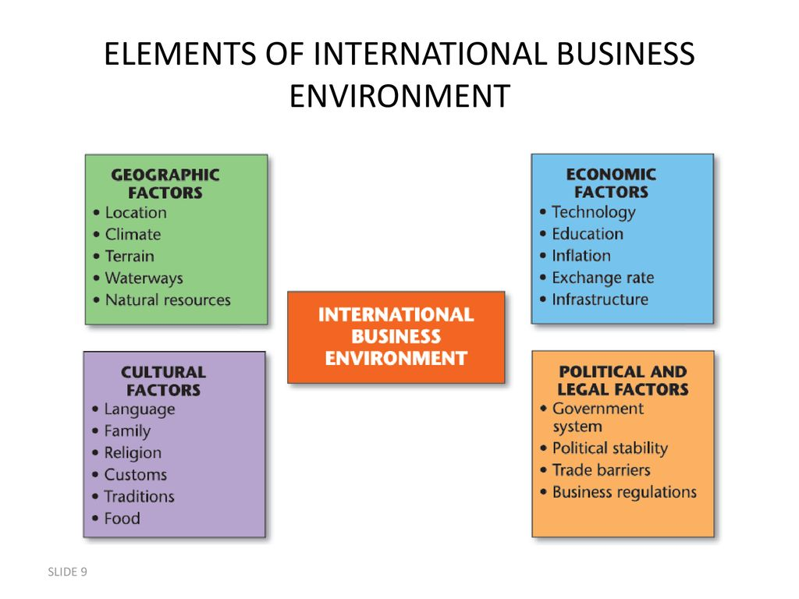

Slide 29
Why IB is Different
The external environment affects a company’s international operations
Managers must understand social science disciplines and how they affect functional business fields
Consider
  Physical factors
  Social factors
  Competitive factors

Slide 30
Physical and Social Factors
Geographic influences
  natural conditions influence business locations
Political policies
  countries determine where and how business occurs within their borders
Legal policies
  influence how a company operates
Behavioral factors
  may require adaptation in to local conditions
Economic forces
  explain differences in costs, currency values, market size

Slide 31
The Competitive Environment
Competitive strategy for products
  Cost strategy
  Differentiation strategy
  Focus strategy
Company resources and experience
  market leaders have more resources for international operations
Competitors faced in each market
  local or international

Slide 32
The Competitive Environment
So, a company’s competitive strategy influences how and where it can best operate
Its competitive situation may differ from country to country in terms of its relative strength and which competitors it faces

